Slide 1
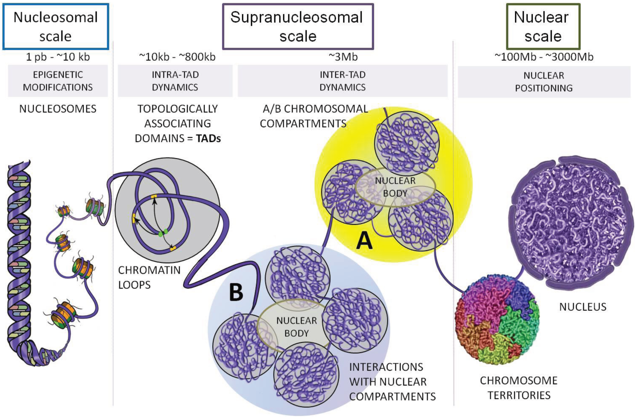
The 3D genome
Ea V, Baudement MO, Lesne A, Forné T. Contribution of Topological Domains and Loop Formation to 3D Chromatin Organization. Genes (Basel). 2015;6(3):734-50.

Slide 2
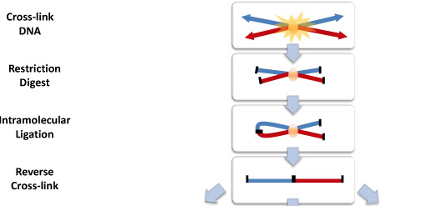
Chromatin Conformation Capture
Used to measure proximity of genomic regions in space
Common basis for all “C” techniques:

Slide 3
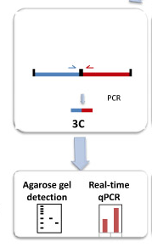
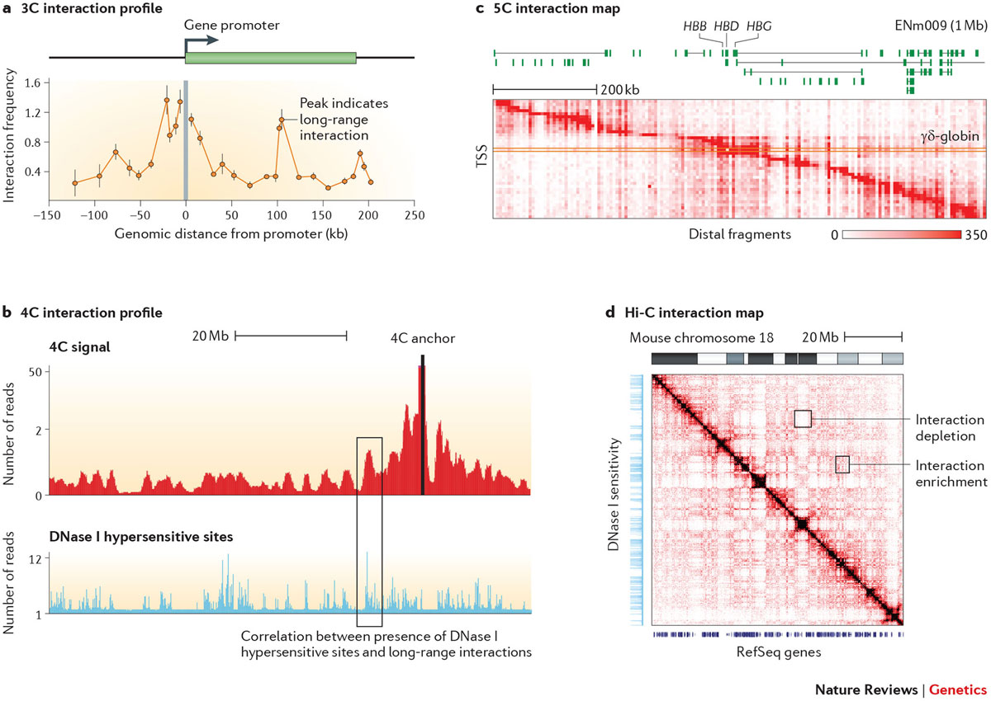
Chromosome Conformation Capture
3C
“One versus one”
Real-time PCR for quantification of ligation product
Requires knowledge of both interacting loci for primer
design.

Slide 4
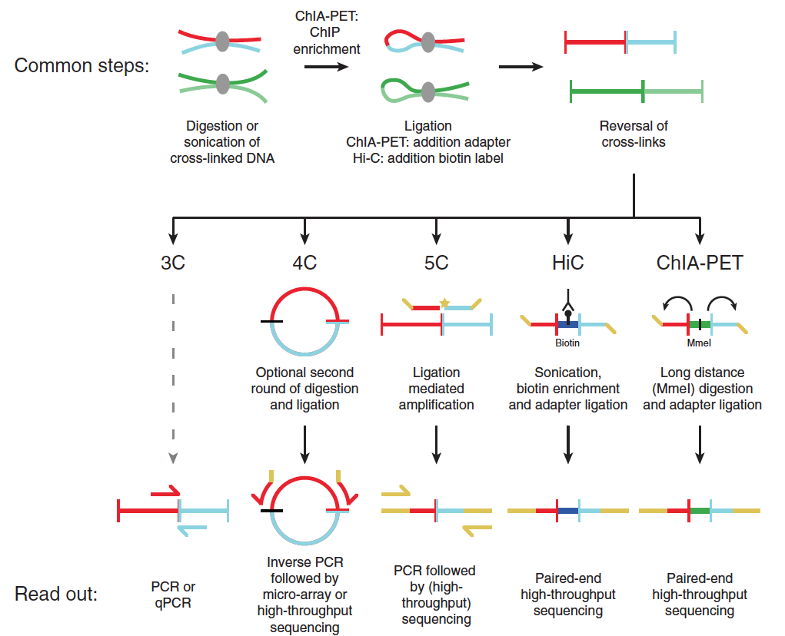
Circularized Chromosome Conformation Capture
4C
“One versus all”
Ligation products are circularized
Inverse PCR: Only requires knowledge of 1 locus
Readout on microarray or
high throughput sequencing
Noordermeer D, Duboule D. Chromatin looping and organization at developmentally regulated gene loci. Wiley Interdiscip Rev Dev Biol. 2013;2(5):615-30.

Slide 5
Carbon Copy Chromosome Conformation Capture
5C
“Many versus many”
Needs primers for all restriction fragments
Unsuitable for whole genome analyses
Maps interactions between all restriction fragments within a given region
Dekker J, Marti-renom MA, Mirny LA. Exploring the three-dimensional organization of genomes: interpreting chromatin interaction data. Nat Rev Genet. 2013;14(6):390-403.

Slide 6
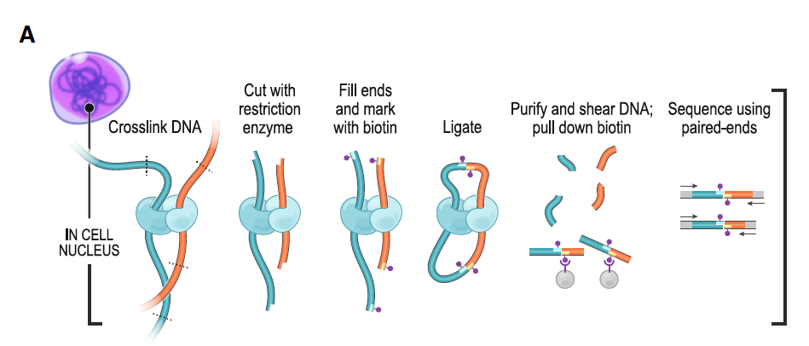
Hi-C
“All versus all”
Biotin labeling before ligation.
High throughput sequencing
Rao et al, 2014. A 3D map of the human genome at kilobase resolution reveals principles of chromatin looping. Cell

Slide 7
Other techniques
Chip-loop
ChIP-seq + 3C
Chia-PET
ChIP-seq + 5C
Single cell Hi-C
Protein-mediated
Contacts only

Slide 8
Interpreting Hi-C data
A
B
C
D
 | A | B | C | D
A
B
C
D
TAD:

Slide 9
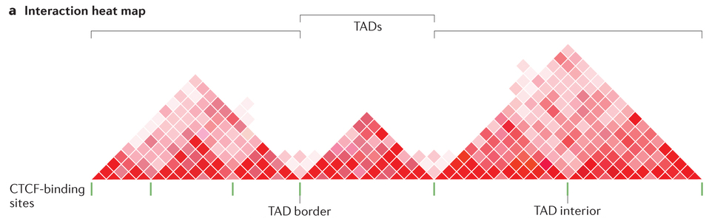
TADs
Area of high chromosomal contacts.
Start and end points of TADs are called “borders”
Regions around borders are called boundaries.
Boundaries are region of high intra-TAD contact that act as insulators, preventing inter-TAD contacts.

Slide 10
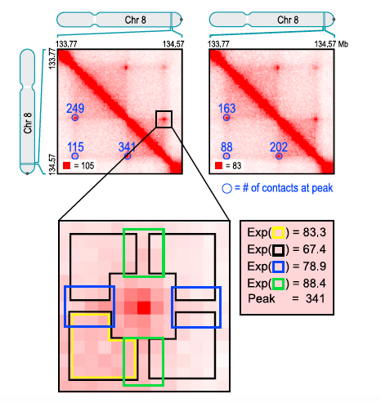
Interpreting Hi-C data
A
B
C
D
Loop:
 | A | B | C | D
A
B
C
D

Slide 11
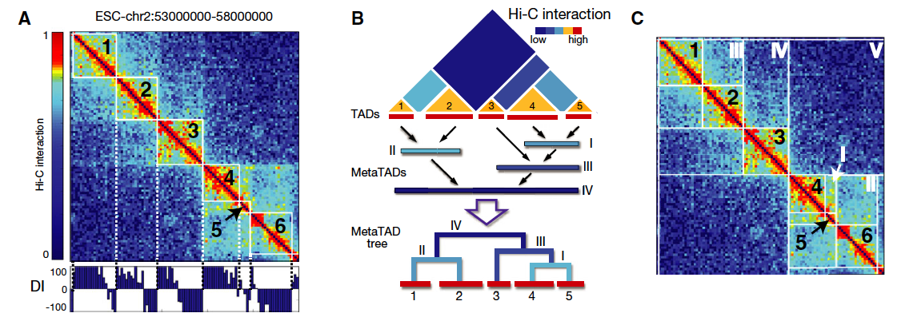
Ambiguous definitions
What amount of contact required to call a loop?
TADs are embedded in larger TADs.
Dynamic structures are hidden by Hi-C
Interest of single-cell Hi-C

